Slide 1

Global Country Macro Dataset
Machine Learning project to predict Infant Mortality Rate
Bhavan's Vivekananda College of Science, Humanities and Commerce
Group 5​
N.Keerthana Reddy​
A.Deepak Mudiraj​
Lokesh Kumar​
K.Manohar

Slide 2
Abstract
Abstract
This project analyzes factors affecting infant mortality rates globally, using variables such as life expectancy, birth rates, GDP, and healthcare metrics. Through regression analysis, significant trends and relationships between socio-economic indicators and infant health outcomes are identified, providing insights into potential areas for policy improvements.
This project analyzes factors affecting infant mortality rates globally, using variables such as life expectancy, birth rates, GDP, and healthcare metrics. Through regression analysis, significant trends and relationships between socio-economic indicators and infant health outcomes are identified, providing insights into potential areas for policy improvements.
Objective
Objective
To identify a suitable machine learning model for predicting infant mortality rates using various socioeconomic and health-related indicators, aiming to improve public health strategies and outcomes.
To identify a suitable machine learning model for predicting infant mortality rates using various socioeconomic and health-related indicators, aiming to improve public health strategies and outcomes.

Slide 3

Content
INTRODUCTION
LITERATURE REVIEW
DATA PREPROCESSING
EXPLORATORY DATA ANALYSIS
DATA MODELING & EVALUATION
SUMMARY
APPENDIX
4
5
7
12
20
27
31

Slide 4
introduction
The global country macro dataset is a collection of detailed information about countries around the world, covering areas like the economy, population statistics, health, and environmental factors. This data helps us understand global trends and patterns, which can be used to make recommendations for better policies.
The dataset includes important details such as a country's economic performance (GDP), birth rates, infant mortality rates, how long people live (life expectancy), the percentage of people living in cities, and employment levels. This gives a complete picture of a country’s overall development and quality of life.
This dataset enables researchers to uncover relationships between variables, identify disparities between countries, and create predictive models supporting informed decision-making in healthcare, economic development, and environmental sustainability.

Slide 5
Literature review-1
Measuring Global Macroeconomic Uncertainty and Cross-Country Uncertainty Spillovers by Graziano Moramarco
Research into global macroeconomic uncertainty often focuses on how uncertainty spreads and affects different countries. A common method used to study this is the Global Vector Autoregressive (GVAR) model. This model helps researchers understand how economic uncertainty in one country can impact others by measuring both local and international sources of uncertainty at the same time.
The GVAR model incorporates a range of indicators, including financial market volatility, economic policy uncertainty, and survey-forecast measures, enabling it to capture fluctuations during significant economic disruptions such as the global financial crisis and the COVID-19 pandemic.

Slide 6
Literature review-2
Measuring the impact of the digital economy in developing countries: A systematic review and meta- analysis by Abdulkarim A. Oloyede
Research indicates that the digital economy is a major driver of global growth, but accurately measuring its impact is difficult, especially in developing nations. Current measurement methods vary and often overlook important aspects, potentially underestimating the digital economy’s full contribution. A unified and flexible measurement system is needed to better assess its impact and guide effective policies for sustainable growth.
Existing indices often fail to fully capture the digital economy’s scope, leading to potential underestimations of its contributions. This highlights the need for a unified, context-sensitive framework that supports accurate measurement and facilitates policy-making for sustainable digital economic growth worldwide.

Slide 7
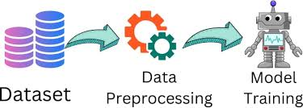
Data preprocessing

Slide 8
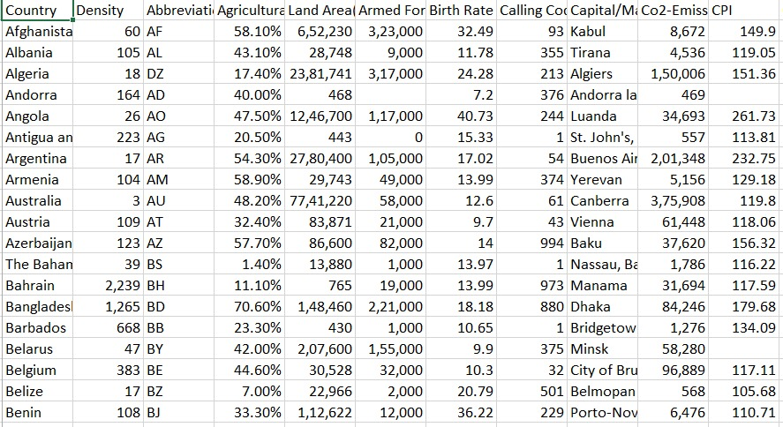
Data
Dataset: Our dataset contains 35 variables and 195 records
Source: https://drive.google.com/drive/folders/1vGSRCnhqSxEH53BgLqhh32F1qNKqfOim?usp=drive_link
Variables:

Slide 9
Continuous variable | Categorical variable
Birth Rate | Abbreviation
Calling Code | Agricultural Land( %)
Fertility rate | Land Area(Km2)
Infant mortality | Armed Forces size
Life expectancy | Capital/Major City
Maternal mortality ratio | Co2-Emissions
Physicians per thousand | CPI
Latitude | CPI Change (%)
Longitude | Currency-Code
 | Forested Area (%)
 | Gasoline Price
 | GDP
 | Gross primary education enrollment (%)
 | Gross tertiary education enrollment (%)
 | Largest city

Slide 10
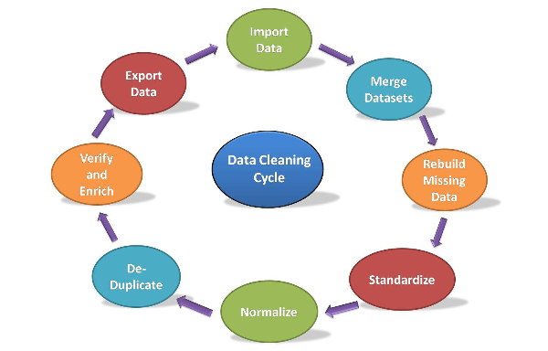
Data Cleaning
Removing Columns: We removed unnecessary columns from the data for our analysis.
Checked for missing values and unique values

Slide 11
We removed symbols from the data, such as '$', '%', and others.
The data does not contain any unique values.
We replaced the missing numeric values with the mean and the missing categorical values with the mode.

Slide 12

EXPLORATORY DATA ANALYSIS

Slide 13
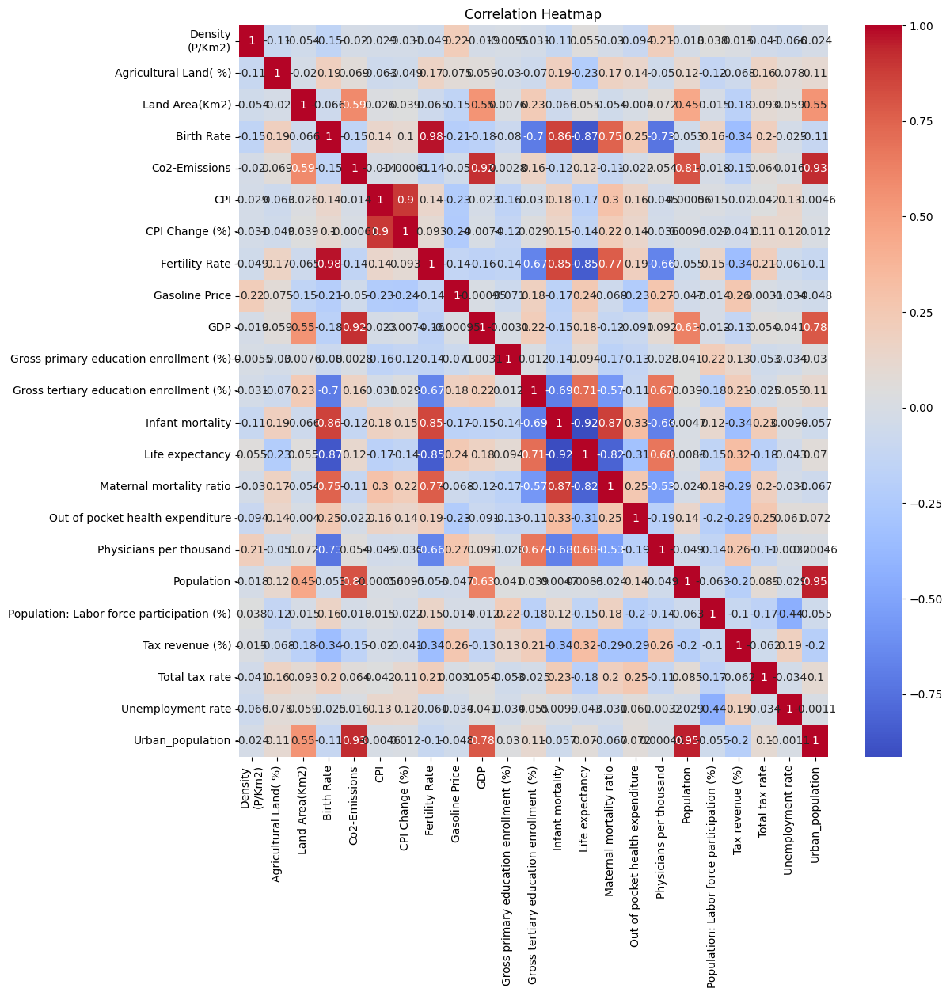
Correlation matrix
The image shows a correlation heatmap depicting the relationships between various socioeconomic and health-related variables.
Each cell in the heatmap represents the correlation coefficient between the pair of variables, with color coding indicating the strength and direction of the correlation.

Slide 14
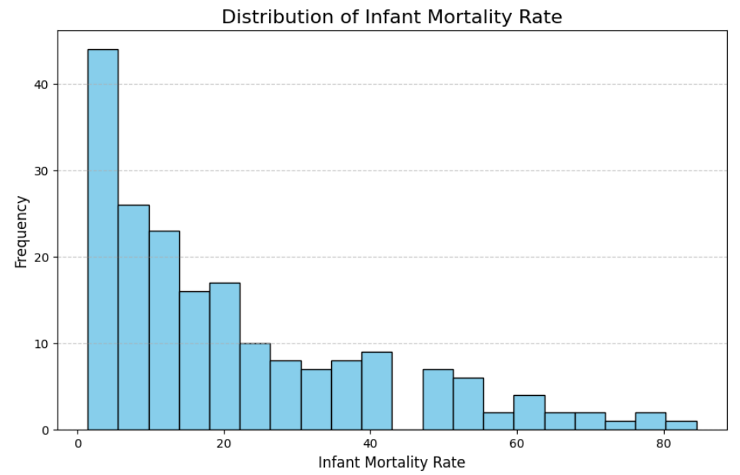
Histogram
The histogram shows the distribution of infant mortality rates. The data is skewed to the right, with most countries having a lower infant mortality rate, and only a few countries showing higher rates above 40.

Slide 15
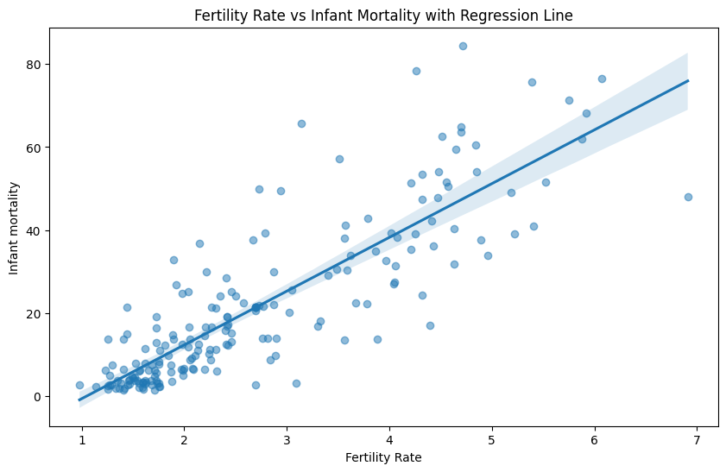
Scatter plot
The scatter plot shows a positive correlation between fertility rate and infant mortality, with a regression line indicating that higher fertility rates are associated with higher infant mortality.

Slide 16
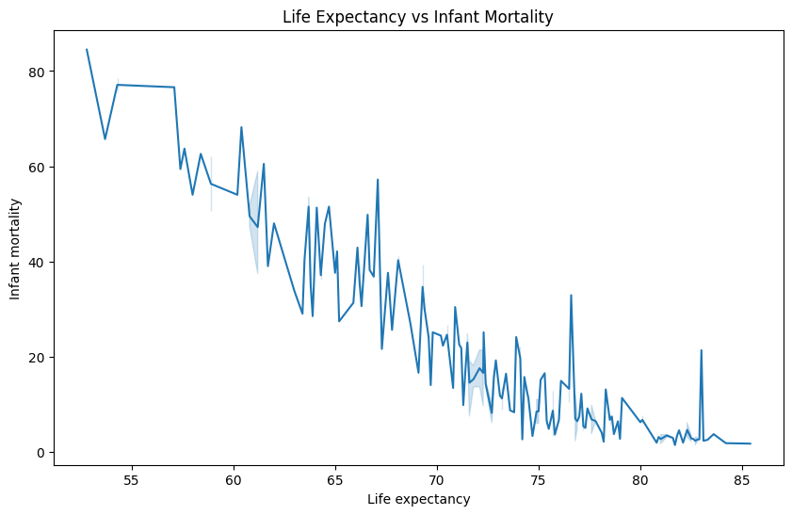
Line plot
The line plot shows an inverse relationship between life expectancy and infant mortality, with infant mortality decreasing as life expectancy increases.

Slide 17
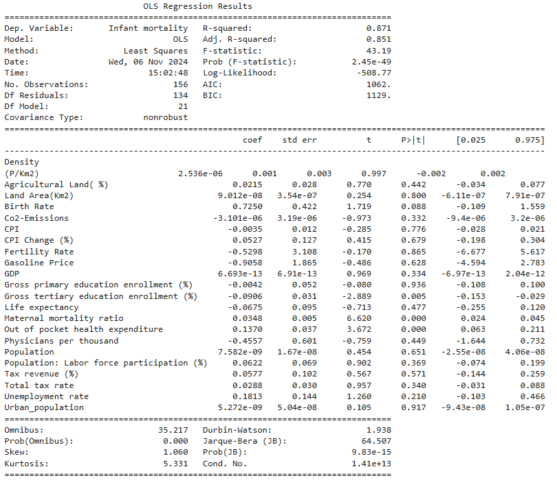
Significance Test​
Fitting ordinary least squares model with all the features: Leading Current Reactive Power(LeRP) has Greatest P-value which is insignificant

Slide 18
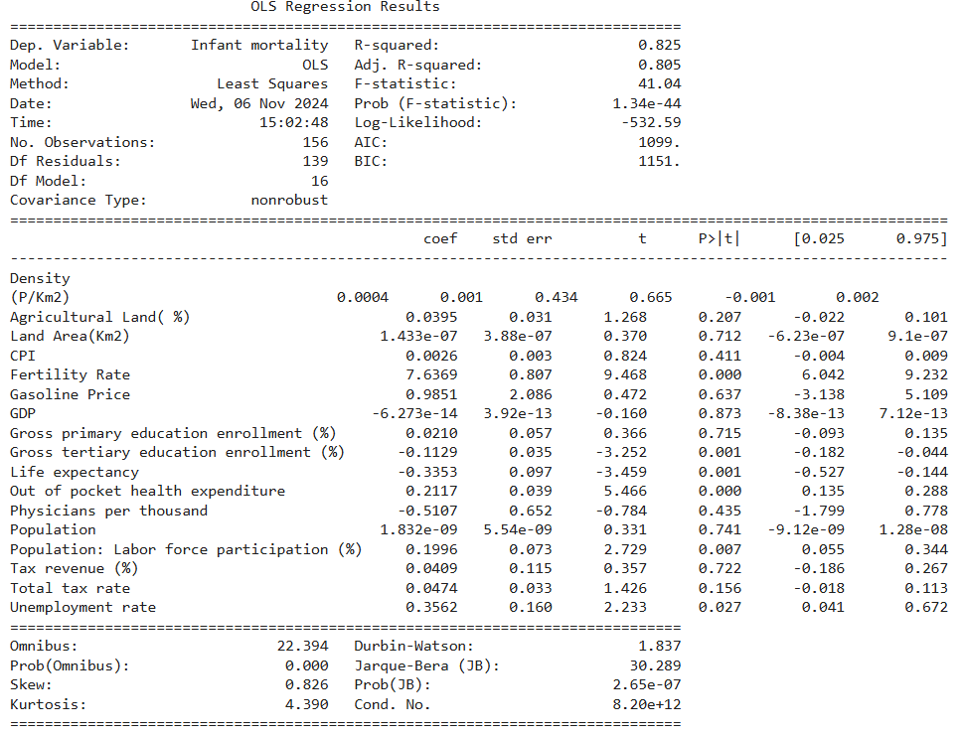
Significance Test​
Removing Insignificant variables: After removing variable having greatest P-value (greater than 0.05)

Slide 19
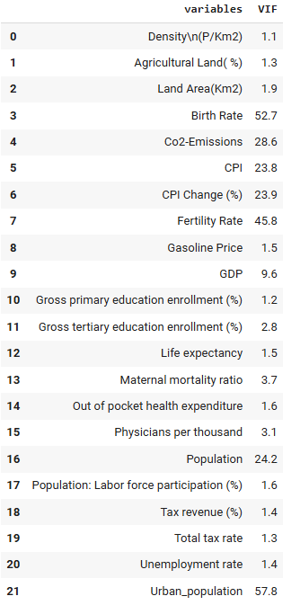
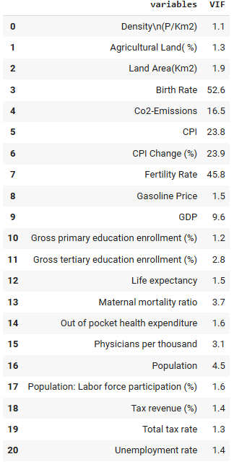
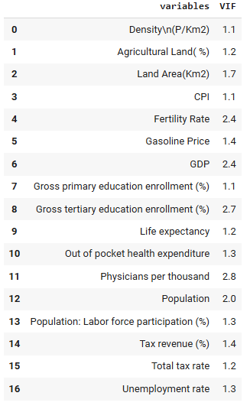
Multicollinearity Check
Variables with the greatest variance inflation factor (VIF >3) were removed

Slide 20

Machine Learning Algorithms

Slide 21
Machine Learning Algorithms
Multiple Linear Regression
K-Nearest Neighbors(KNN)
Decision Tree
Random Forest
Bagging
Boosting
Support Vector Machine(SVM)

Slide 22
80:20 Train-Test Split Ratio
Algorithms | Model 1 (r^2) | Model 2 (r^2) | Model 1 (MAE) | Model 2 (MAE)
Linear Regression | 0.872 | 0.856 | 2.256 | 2.369
KNN | -0.152 | -0.152 | 15.695 | 15.695
Decision Tree Regressor | 0.798 | 0.808 | 5.783 | 5.861
Random Forest | 0.890 | 0.800 | 4.114 | 5.592
XG Boost | 0.840 | 0.80 | 4.924 | 5.59
Ada Boost | -0.041 | -0.041 | 5.088 | 5.104
SVM | -0.041 | 0.866 | 12.862 | 5.104
ANN | 0.892 | 0.914 | 4.215 | 3.537
R² Score:
The R² score measures how well the independent variables (predictors) explain the variation in the dependent variable (target). It tells you how well your regression model fits the data.
Mean Absolute Error (MAE):
The MAE measures the average magnitude of the errors in a regression model. It calculates how far the predicted values are, on average, from the actual values.
Model 1: With all features | Model 2: After removing multi-collinear variables

Slide 23
75:25 Train-Test Split Ratio
Algorithms | Model 1 (r^2) | Model 2 (r^2) | Model 1 (MAE) | Model 2 (MAE)
Linear Regression | 0.849 | 0.862 | 2.346 | 2.383
KNN | 0.004 | 0.004 | 15.199 | 15.199
Decision Tree Regressor | 0.844 | 0.823 | 5.436 | 5.659
Random Forest | 0.892 | 0.890 | 4.307 | 4.503
XG Boost | 0.884 | 0.857 | 4.777 | 5.357
Ada Boost | -0.112 | -0.111 | 4.833 | 5.251
SVM | -0.112 | -0.111 | 14.267 | 14.267
ANN | 0.884 | 0.861 | 4.795 | 4.978
Model 1: With all features | Model 2: After removing multi-collinear variables

Slide 24
70:30 Train-Test Split Ratio
Algorithms | Model 1 (r^2) | Model 2 (r^2) | Model 1 (MAE) | Model 2 (MAE)
Linear Regression | 0.891 | 0.873 | 2.241 | 2.395
KNN | -0.042 | -0.042 | 15.834 | 15.834
Decision Tree Regressor | 0.759 | 0.689 | 6.312 | 7.451
Random Forest | 0.889 | 0.875 | 4.565 | 4.999
XG Boost | 0.900 | 0.861 | 4.667 | 5.095
Ada Boost | -0.149 | -0.149 | 5.519 | 5.421
SVM | -0.149 | -0.149 | 15.134 | 15.133
ANN | 0.867 | 0.859 | 4.797 | 5.221
Model 1: With all features | Model 2: After removing multi-collinear variables

Slide 25
60:40 Train-Test Split Ratio
Algorithms | Model 1 (r^2) | Model 2 (r^2) | Model 1 (MAE) | Model 2 (MAE)
Linear Regression | 0.856 | 0.788 | 2.321 | 2.539
KNN | -0.011 | -0.011 | 14.997 | 14.997
Decision Tree Regressor | 0.766 | 0.802 | 6.157 | 5.784
Random Forest | 0.877 | 0.872 | 4.467 | 4.750
XG Boost | 0.849 | 0.844 | 4.910 | 5.152
Ada Boost | -0.131 | -0.131 | 5.163 | 5.449
SVM | -0.131 | 0.851 | 5.449 | 14.272
ANN | 0.682 | 0.677 | 6.343 | 0.084
Model 1: With all features | Model 2: After removing multi-collinear variables

Slide 26
Algorithm Comparision (80:20)
Model 1
Model 2
Algorithms | R^ 2 score
Linear Regression | 0.872
KNN | -0.152
Decision Tree Regressor | 0.798
Random Forest | 0.890
XG Boost | 0.840
Ada Boost | -0.041
SVM | -0.041
ANN | 0.892
Algorithms | R^ 2 score
Linear Regression | 0.856
KNN | -0.152
Decision Tree Regressor | 0.808
Random Forest | 0.800
XG Boost | 0.80
Ada Boost | -0.041
SVM | 0.866
ANN | 0.914

Slide 27
Summary
This project explores global country-level macroeconomic, demographic, and social indicators to analyze their impact on infant mortality rates. Using a dataset that includes variables such as GDP, life expectancy, fertility rate, birth rate, and healthcare factors, the goal is to understand the underlying relationships that influence infant mortality across different regions.
Statistical analysis and machine learning models identify key predictors of infant mortality, with visualizations like line plots, scatter plots, and heatmaps highlighting relationships and trends to inform policy interventions.
The Artificial Neural Network (ANN) model proved to be the most effective for predicting infant mortality in both Model 1 and Model 2. It demonstrated superior accuracy by effectively capturing complex relationships between factors such as GDP and healthcare spending. The ANN outperformed other models, providing reliable predictions without overfitting. These results offer valuable insights for formulating policies to reduce infant mortality rates.

Slide 28
Future Scope
Better Models: Using more advanced machine learning models could improve predictions for infant mortality, making the results more accurate.
Regional Focus: Analyzing the data separately for different regions could help understand local factors that affect infant mortality better.
Looking at Changes Over Time: Including historical data could show how infant mortality rates have changed over the years and help identify patterns.
Adding More Data: Including extra data, like healthcare quality or environmental factors, could give a clearer picture of what impacts infant mortality.
Testing Policies: Developing a model that tests the effects of policies (like improving healthcare or education) on infant mortality could guide decision-making.

Slide 29

Work Distribution
Team | Work
Lokesh Kumar | Collect information about Global data & Literature Review
K.Manohar | Data Preprocessing
A.Deepak Mudiraj | Exploratory Data Analysis
N.Keerthana Reddy | Implement Machine Learning Algorithms

Slide 30

Thank You
Group 5​​
N.Keerthana Reddy​​
A.Deepak Mudiraj​​
Lokesh Kumar​​
K.Manohar

Slide 31


Slide 32
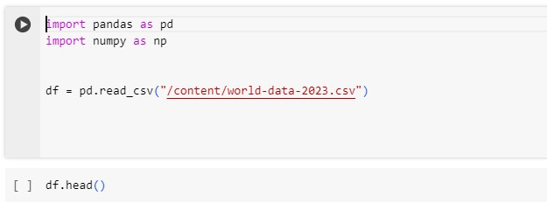
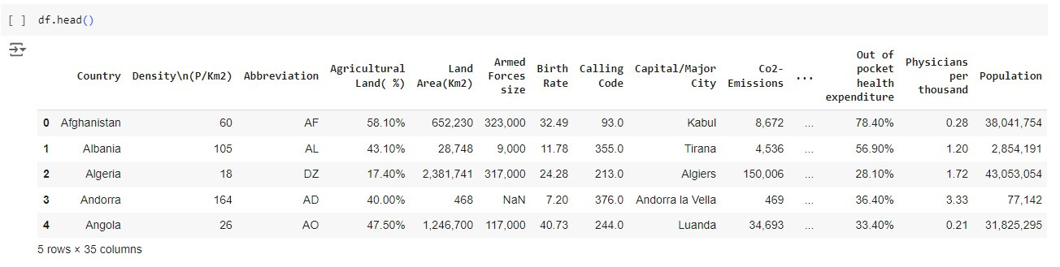
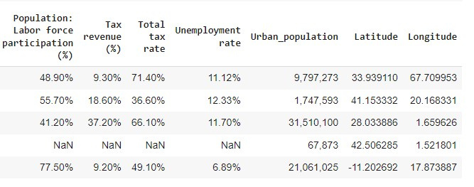
Loading the Data

Slide 33
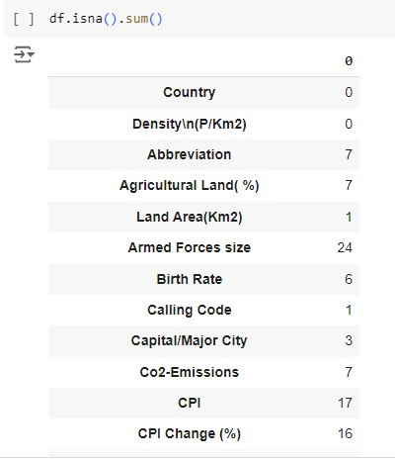
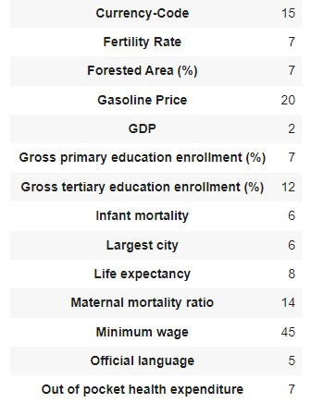
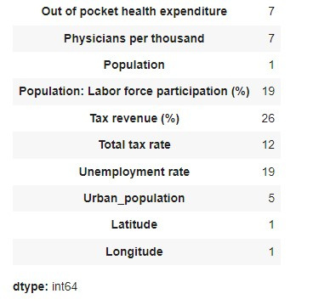
Null Values

Slide 34
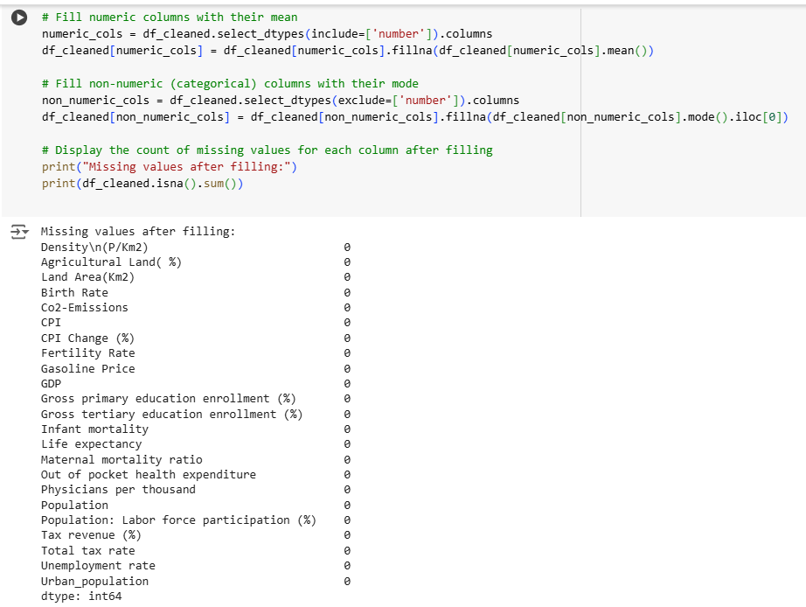
Null Values

Slide 35
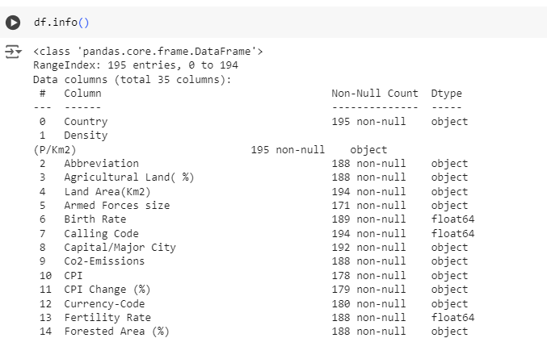
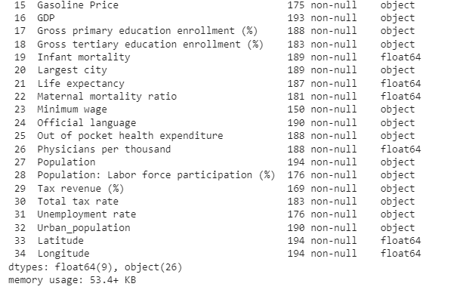
Checking For the Data type

Slide 36
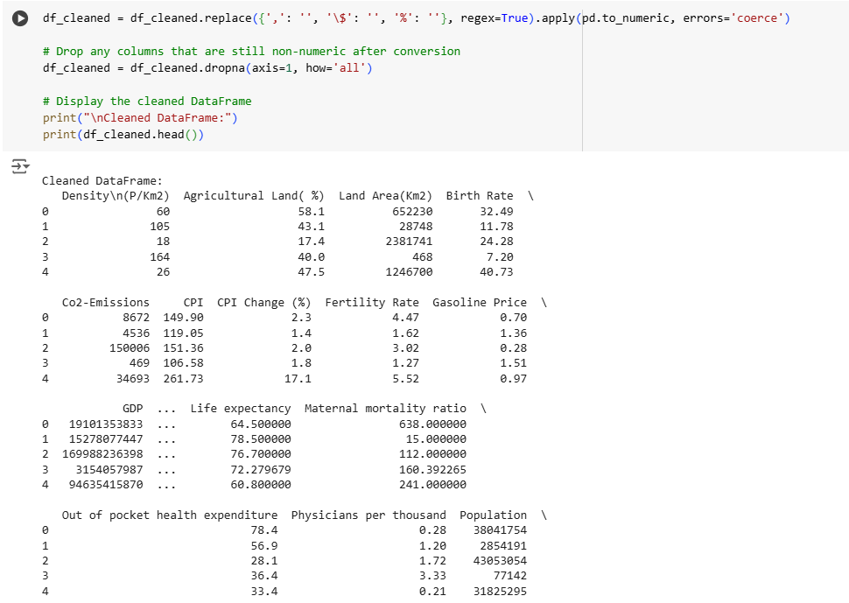
Replacing the symbols

Slide 37
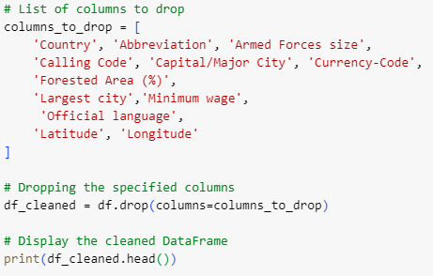
Dropping The columns

Slide 38
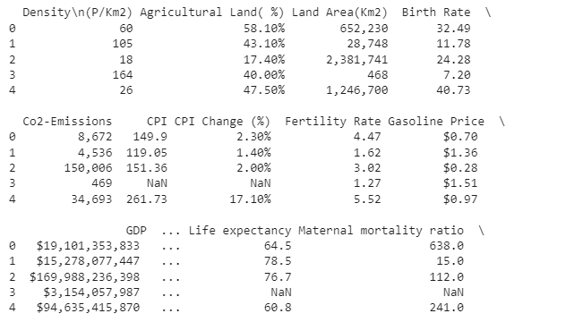
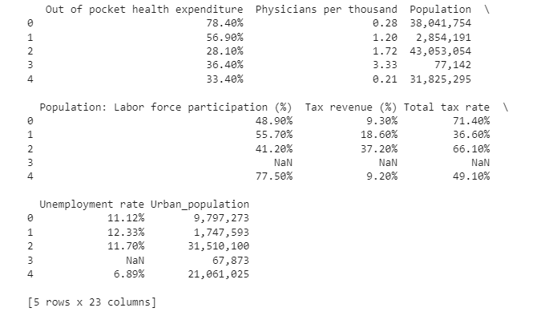
Dropping The columns

Slide 39
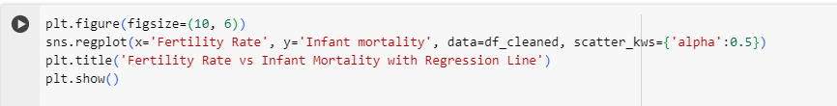
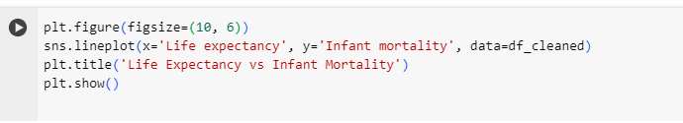
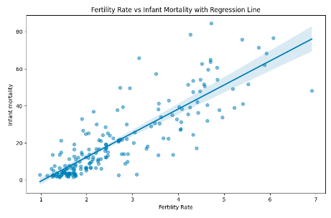
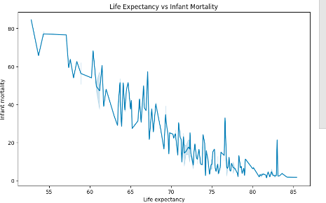
Data Visualization

Slide 40
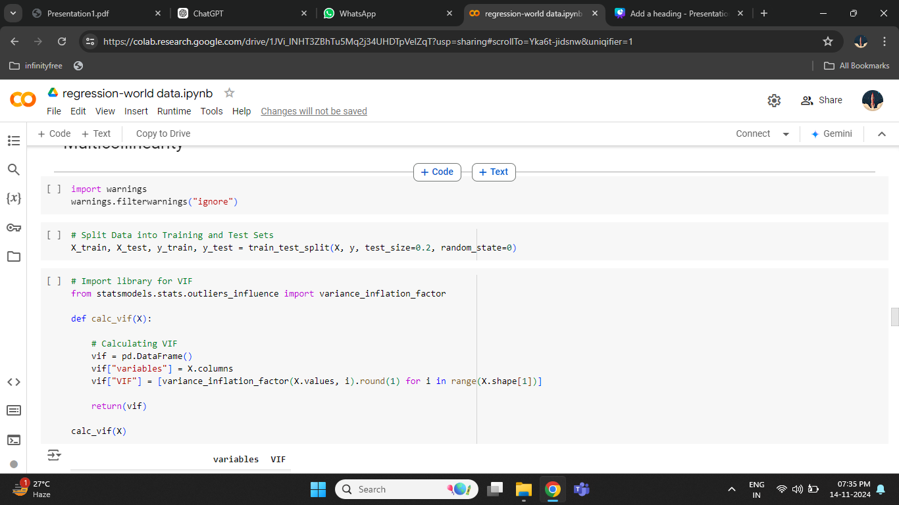
Multicollinearity Check

Slide 41
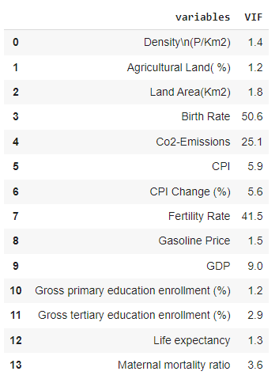
Multicollinearity Check

Slide 42
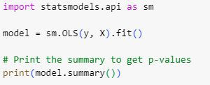
Ordinary Least Square

Slide 43
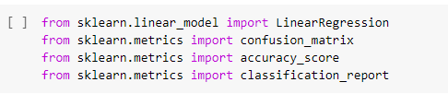
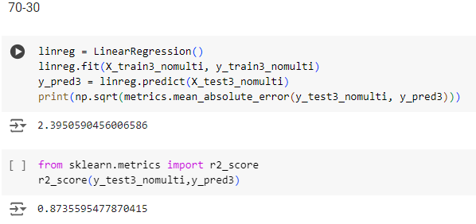
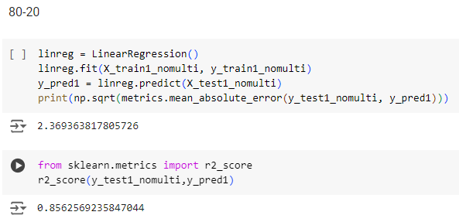
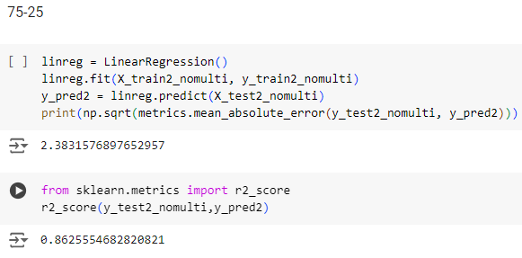
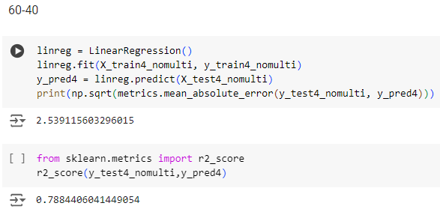
Linear Regression

Slide 44
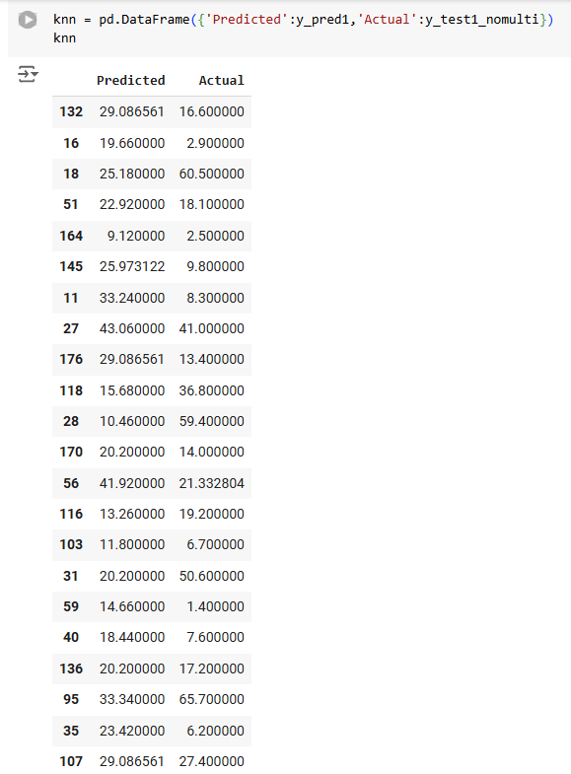
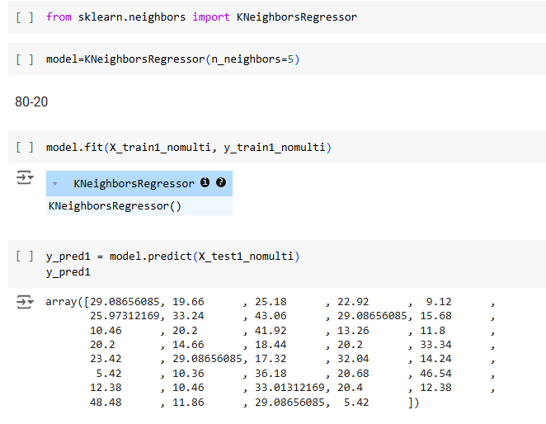
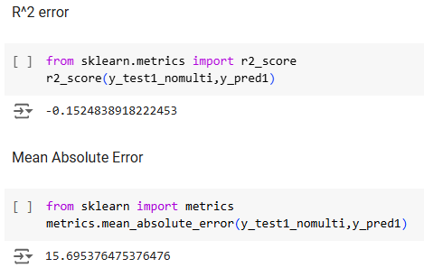
K-Nearest Neighbors

Slide 45
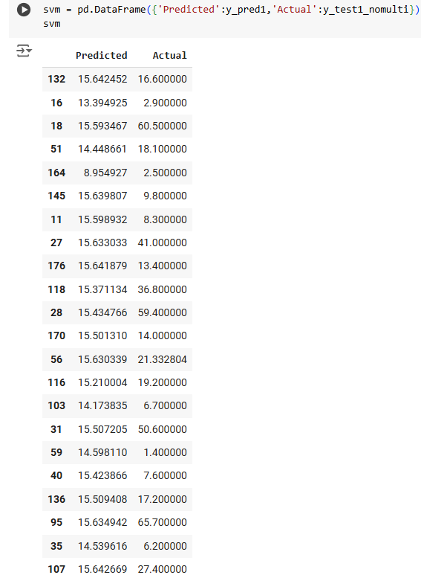
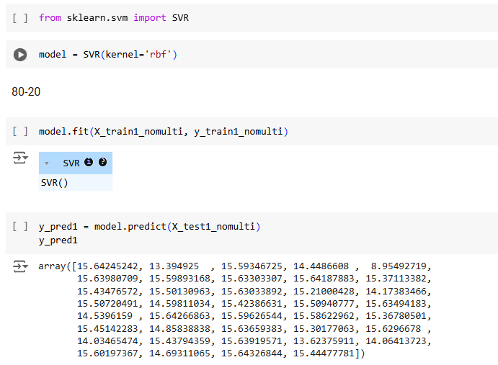
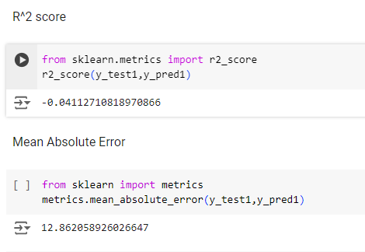
Support Vector Machine

Slide 46
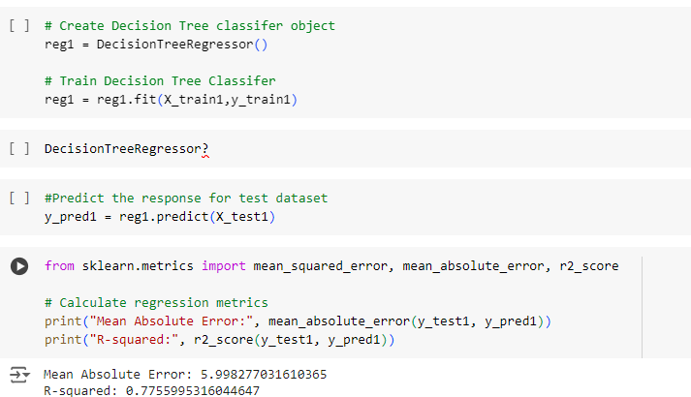
Decision Tree

Slide 47
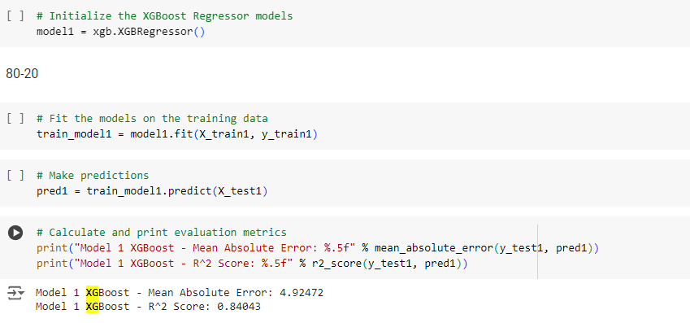
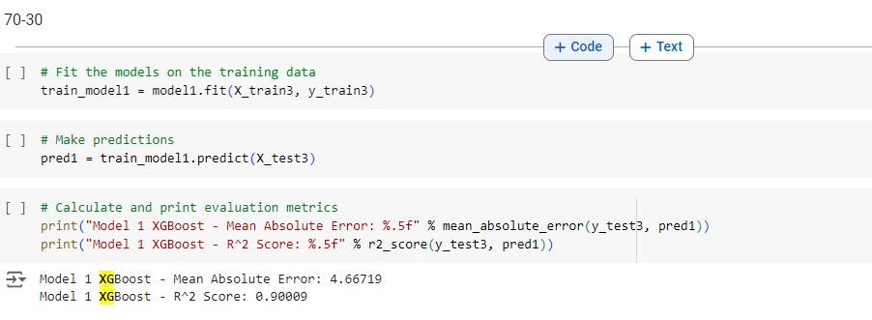
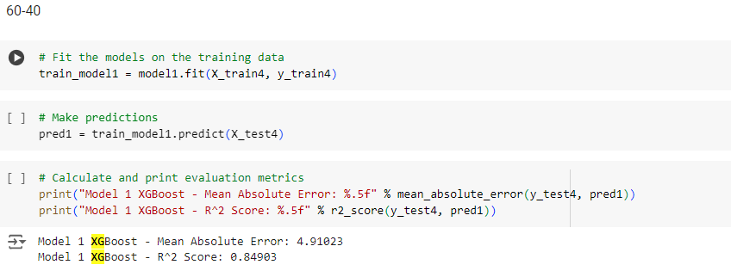
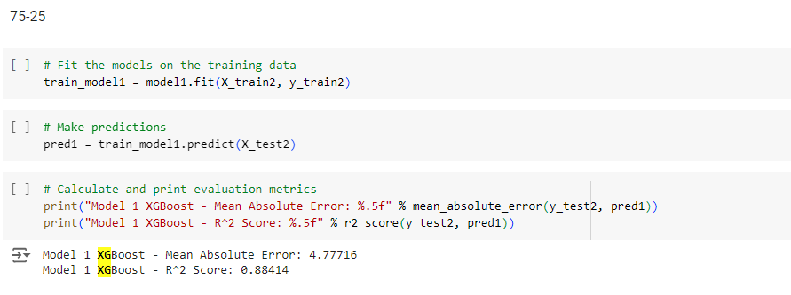
XG Boost

Slide 48
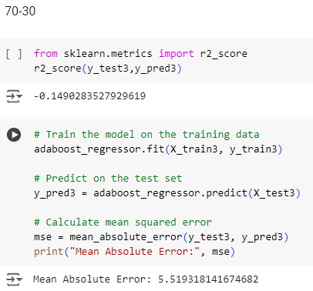
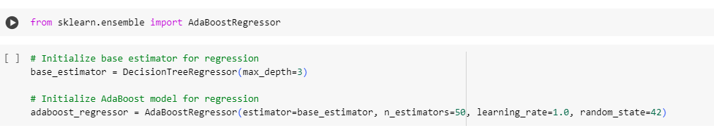



ADA Boost

Slide 49


Bagging(Random Forest)

